Slide 1

Project Final Review on
POWER SYSTEM FAULT DIAGNOSIS USING MACHINE LEARNING
by
under the guidance of
Dr . S. Hemachandra M.Tech., Ph.D.
Professor
DEPARTMENT OF ELECTRICAL AND ELECTRONICS ENGINEERING
SREE VIDYANIKETHAN ENGINEERING COLLEGE
(AUTONOMOUS)
A.RANGAMPET, TIRUPATI – 517 102
(2016 - 2020)
EDAGOTTI PAVANKUMAR | 16121A0253
AVILALA DEDEEPYA | 16121A0208
GAYAKAWADA CHANDRASEKHAR | 16121A0265
AVULA PRAVALIKA | 16121A0209

Slide 2
Contents :
Objective
Introduction
Problem Identification
Existing Methods
Proposed Method
Description of proposed method
Mathematical Modeling
Simulation and Results
Conclusion
Future Scope
References

Slide 3
Objective
The main objective of our project is detection, classification and location identification of faults on transmission lines by using historical fault data with the help of deep neural networks.

Slide 4
Introduction
From past few decades we are very much depending on the electric power.
Transmission lines are the bridge between generating stations to distribution stations.
Faults in the transmission lines are common but the protection is necessary to protect the system.
A fast and reliable protection scheme is required to protect the system and for reliable power supply.

Slide 5
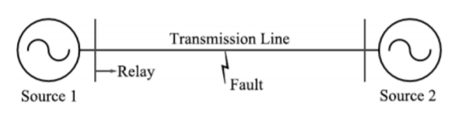
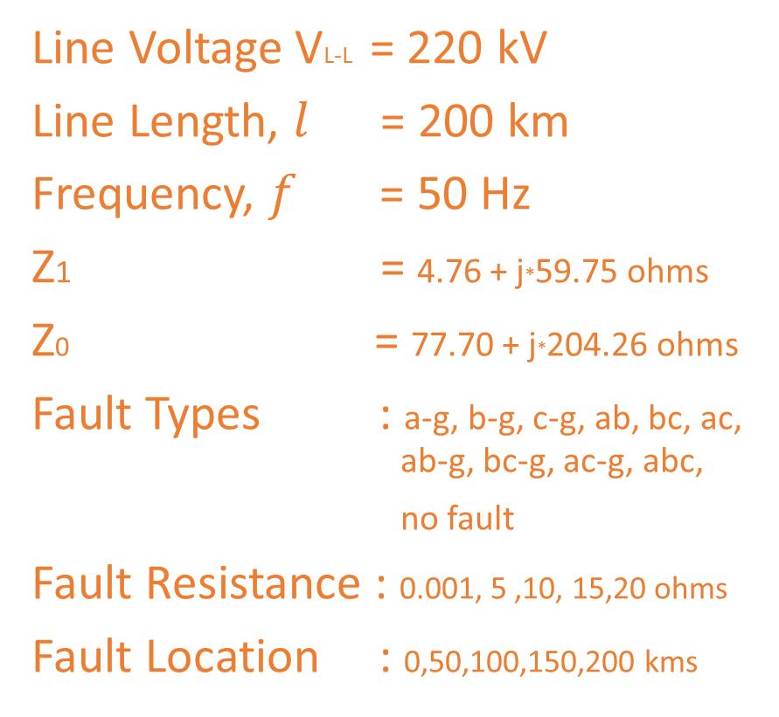
Problem Identification
Line Voltage VL-L = 220 kV
Line Length, $l$ = 200 km
Frequency, $f$ = 50 Hz
Z1 = 4.76 + j*59.75 ohms
Z0 = 77.70 + j*204.26 ohms
Fault Types : a-g, b-g, c-g, ab, bc, ac, ab-g, bc-g, ac-g, abc,
no fault
Fault Resistance : 0.001, 5 ,10, 15,20 ohms
Fault Location : 0,50,100,150,200 kms
Fig. 1. Transmission network considered for the simulations

Slide 6
Existing Methods
There are several methods for detection and classification, location identification of faults on the transmission lines.
We are classifying the existing methods into two categories
1. Fault detection and classification methods
2. Fault location Identification methods
Each method has its own merits and demerits

Slide 7
Fault Classification Methods
(Cont..)
Wavelet Transforms
Artificial Neural Networks (ANN)
Fuzzy Logic
Neuro-Fuzzy Techniques
Wavelet and Neuro-Fuzzy Techniques
Genetic Algorithms
Support Vector Machines (SVM)
Phasor Measurement Units (PMU) protection schemes etc.

Slide 8
Fault Location Identification Methods
(Cont..)
Impedance Measurement based techniques
Travelling Wave based techniques
Knowledge Based Methods
1. Fuzzy Logic
2. Artificial Neural Network
3. Genetic Algorithms etc.

Slide 9
Proposed Method
We are divided fault detection, classification and location identification into two problems
1. Fault detection and classification
2. Fault location Identification
We had used two Partially Recurrent Neural networks (PRNN) for each problem.

Slide 10
Description of the Proposed Method
We had simulated fault data using MATLAB/SIMULINK.
Using NeuroSolutions we had trained PRNN with training data.
With the help of cross-validation prevented overfitting and underfitting.
Finally trained network will be tested with testing data.

Slide 11
Mathematical Modeling
Network will extract the features itself, we can’t identify what features it was extracted. We can judge the classification based on boundary conditions.
For fault location identification we can’t derives any model apart from impedance measurement and travelling wave method models.

Slide 12
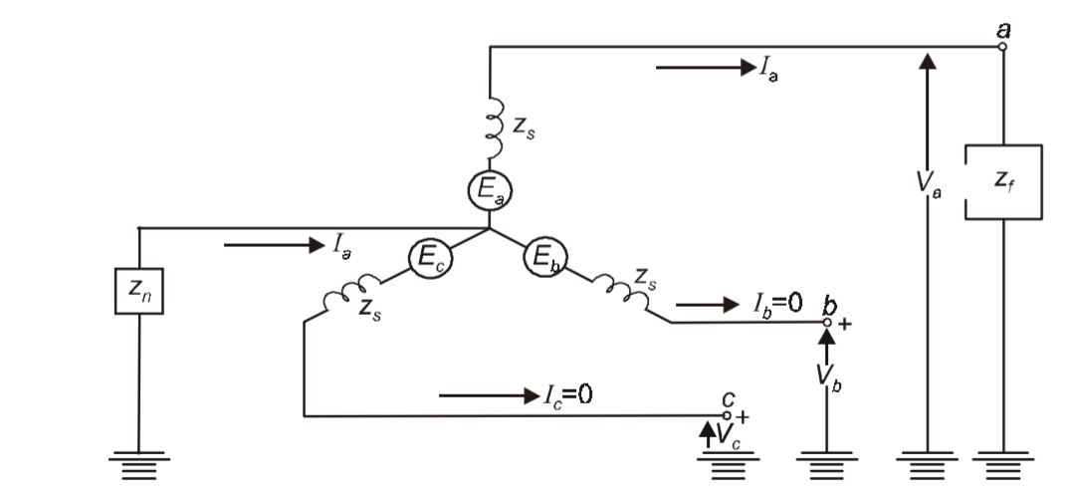

Single line to ground fault
(Cont..)
Assume that fault occurred in phase a
Boundary Conditions:
$$V_{a}=Z_{f}I_{a}$$
$$I_{b}=I_{c}=0$$
Fig. 2 L-G Fault at phase a

Slide 13
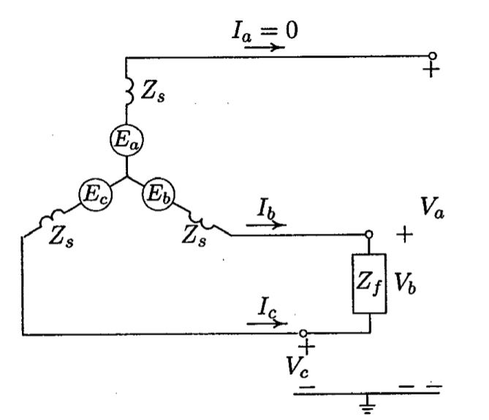

Line to Line fault
(Cont..)
Boundary Conditions:
$$V_{b}−V_{c}=Z_{f}I_{b}$$
$$I_{b}+I_{c}=0$$
Fig. 3 LL Fault between phase b and c

Slide 14
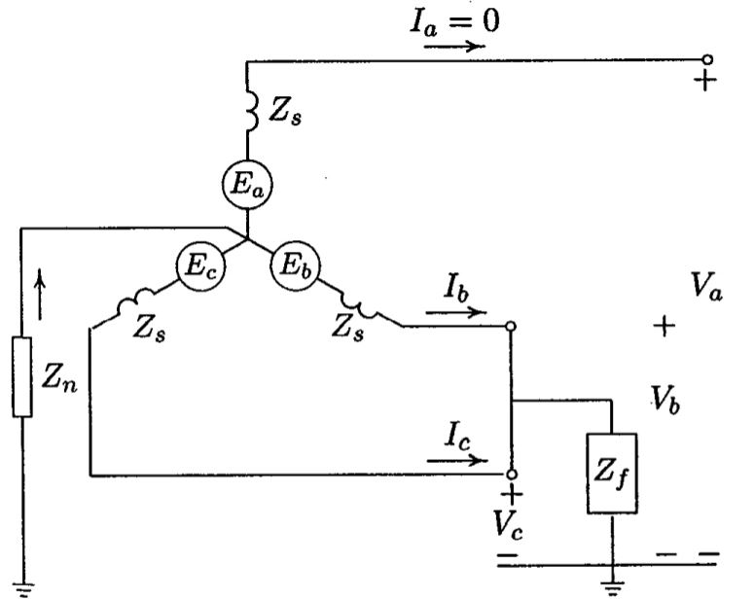

Double line to ground fault
(Cont..)
Boundary Conditions:
$$V_{b}=V_{c}=Z_{f}\left(I_{b}+I_{c}\right)$$
$$I_{a}=I_{a}^{0}+I_{a}^{1}+I_{a}^{2}=0$$
Fig. 4 LL-G Fault between phase b and c

Slide 15

Balanced 3-$φ$ fault
(Cont..)
For 3-$φ$ balanced faults the phase voltages and currents are balanced and the phase shift will be 120 degrees.

Slide 16
Simulation and Results
Table 1. Network Parameters for fault classification and location identification
Parameter | Values
Neural Network | PRNN
Learning Rule | Momentum
Weight Update | Online
Hidden Layers | 5
Processing Elements | 35-35-35-35-35

Slide 17
(Cont..)
Training of fault classification network
Best Networks | Training | Cross Validation
Epoch # | 1000 | 1000
Minimum MSE | 4.22383E-05 | 3.7915E-05
Final MSE | 4.22383E-05 | 3.7915E-05
Table 2. Training Results
Fig. 5. MSE vs Epoch for Training with 5 hidden layers

Slide 18
(Cont..)
Training of fault location identification network
Best Networks | Training | Cross Validation
Epoch # | 1000 | 1000
Minimum MSE | 0.000151775 | 0.000134924
Final MSE | 0.000151775 | 0.000134924
Table. 3. Training Results
Fig. 6. MSE vs Epoch for Training with 5 hidden layers

Slide 19
(Cont..)
Output / Desired | No Fault | AG | BG | CG | AC | BC | CA | ABG | BCG | CAG | ABC
No Fault | 151 | 0 | 0 | 0 | 0 | 0 | 0 | 0 | 0 | 0 | 0
AG | 0 | 366 | 0 | 0 | 0 | 0 | 0 | 0 | 0 | 0 | 0
BG | 0 | 0 | 391 | 0 | 0 | 0 | 0 | 0 | 0 | 0 | 0
CG | 0 | 0 | 0 | 380 | 0 | 0 | 0 | 0 | 0 | 0 | 0
AC | 0 | 0 | 0 | 0 | 393 | 0 | 0 | 0 | 0 | 0 | 0
BC | 0 | 0 | 0 | 0 | 0 | 369 | 0 | 0 | 0 | 0 | 0
CA | 0 | 0 | 0 | 0 | 0 | 0 | 373 | 0 | 0 | 0 | 0
ABG | 0 | 0 | 0 | 0 | 0 | 0 | 0 | 356 | 0 | 0 | 0
BCG | 0 | 0 | 0 | 0 | 0 | 0 | 0 | 0 | 410 | 0 | 0
CAG | 0 | 0 | 0 | 0 | 0 | 0 | 0 | 0 | 0 | 329 | 0
ABC | 0 | 0 | 0 | 0 | 0 | 0 | 0 | 0 | 0 | 0 | 382
Table. 4. Classification Results

Slide 20
(Cont..)
Performance | No_Fault | AG | BG | CG | AC | BC | CA | ABG | BCG | CAG | ABC
MSE | 3.76583E-06 | 0.000258642 | 8.80984E-06 | 5.34328E-06 | 3.77744E-06 | 6.22469E-06 | 3.48316E-06 | 4.5409E-06 | 1.27944E-05 | 4.4779E-06 | 2.73689E-06
MAE | 0.001321413 | 0.006429595 | 0.001957132 | 0.001364944 | 0.001324566 | 0.001731786 | 0.001358941 | 0.001498223 | 0.002151007 | 0.001334154 | 0.001124385
r | 0.9999514 | 0.998652115 | 0.999953224 | 0.999970318 | 0.999979301 | 0.999964841 | 0.999980127 | 0.999973549 | 0.999985429 | 0.999971576 | 0.999984784
Table 5. Classification Results

Slide 21
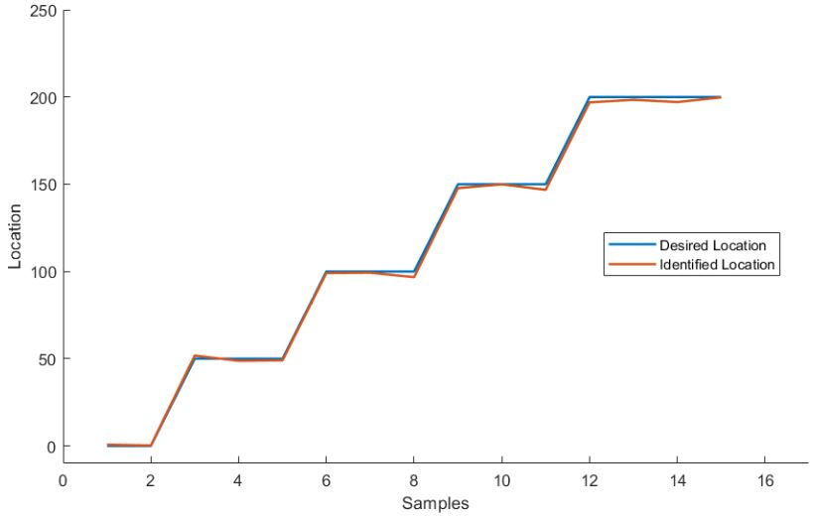
(Cont..)
Performance | Location
MSE | 3.158307138
MAE | 1.276490649
r | 0.99969047
Table 4. Classification Results
Fig. 7. Desired location and Identified Location

Slide 22
Conclusion
The Power system fault diagnosis is addressed using deep neural networks .There are several parameters to consider for a particular power system. The partially recurrent neural network giving a satisfactory performance for the given data set. The classification network is classifying the faults accurately. The fault location identification network is also locating the faults with very less error.

Slide 23
Future scope
The future scope of this project is to study the effect of fault inception angle variation, the variation of high fault resistance.In real-time may be no chance of simple two bus system. We can study large systems with multiple buses in the network.

Slide 24
References
[1] | K. Chen, J. Hu and J. He, "Detection and Classification of Transmission Line Faults Based on Unsupervised Feature Learning and Convolutional Sparse Autoencoder," in IEEE Trans. on Smart Grid, vol. 9, no. 3, pp. 1748-1758, May 2018.
[2] | Youssef, O.A.: ‘Fault classification based on wavelet transforms’. IEEE/PES Transmission and Distribution Conf. and Exposition, 2001, pp. 531–536.
[3] | Lin, W.M., Yang, C.D., Lin, J.H., et al.: ‘A fault classification method by RBF neural network with OLS learning procedure’, IEEE Trans. Power Deliv., 2001, 16, pp. 473–477.
[4] | Kashyap, K.H., Shenoy, U.J.: ‘Classification of power system faults using wavelet transforms and probabilistic neural networks’. Proc. 2003 Int. Symp. On Circuits and Systems, 2003, ISCAS’03, 2003, vol. 3, pp. III-423–III-426.
[5] | Chanda, D., Kishore, N.K., Sinha, A.K.: ‘A wavelet multiresolution analysis for location of faults on transmission lines’, Int. J. Electr. Power Energy Syst., 2003, 25, pp. 59–69.
[6] | Sanaye-Pasand, M., Khorashadi-Zadeh, H.: ‘Transmission line fault detection & phase selection using ANN’, Int. Conf. Power Systems Transients, New Orleans, USA, September 2003, pp. 33–53.
[7] | Pradhan, A.K., Routray, A., Pati, S., et al.: ‘Wavelet fuzzy combined approach for fault classification of a series-compensated transmission line’, IEEE Trans. Power Deliv., 2004, 19, pp. 1612–1618.
[8] | Khorashadi-Zadeh, H.: ‘Artificial neural network approach to fault classification for double circuit transmission lines’. 2004 IEEE/PES Transmission & Distribution Conf. & Exposition, Latin America, 2004, pp. 859–862.

Slide 25
[9] | Dash, P.K., Samantaray, S.R.: ‘An accurate fault classification algorithm using a minimal radial basis function neural network’, Eng. Intell. Syst. Electr. Eng. Commun., 2004, 12, pp. 205–210.
[10] | Mahanty, R.N., Dutta Gupta, P.B.: ‘Application of RBF neural network to fault classification and location in transmission lines’, IEEE Proc., Gener. Transm. Distrib., 2004, 151, p. 201.
[11] | Thukaram, D., Khincha, H.P., Vijaynarasimha, H.P.: ‘Artificial neural network and support vector machine approach for locating faults in radial distribution systems’, IEEE Trans. Power Deliv., 2005, 20, pp. 710–721.
[12] | Sedighi, A.-R., Haghifam, M.-R., Malik, O., et al.: ‘High impedance fault detection based on wavelet transform and statistical pattern recognition’, IEEE Trans. Power Deliv., 2005, 20, pp. 2414–2421.
[13] | Silva, K.M., Souza, B.A., Brito, N.S.D.: ‘Fault detection and classification in transmission lines based on wavelet transform and ANN’, IEEE Trans. Power Deliv., 2006, 21, pp. 2058–2063.
[14] | Jayabharata Reddy, M., Mohanta, D.K.: ‘A wavelet-fuzzy combined approach for classification and location of transmission line faults’, Int. J. Electr. Power Energy Syst., 2007, 29, pp. 669–678.
[15] | Jung, C.K., Kim, K.H., Lee, J.B., et al.: ‘Wavelet and neuro-fuzzy based fault location for combined transmission systems’, Int. J. Electr. Power Energy Syst., 2007, 29, pp. 445–454.
[16] | Parikh, U.B., Das, B., Maheshwari, R.P.: ‘Combined wavelet-SVM technique for fault zone detection in a series compensated transmission line’, IEEE Trans. Power Deliv., 2008, 23, pp. 1789–1794.
[17] | Upendar, J., Gupta, C.P., Singh, G.K.: ‘Discrete wavelet transform and probabilistic neural network based algorithm for classification of fault on transmission systems’. Proc. of the Indicon 2008 IEEE Conf. & Exhibition on Control, Communications and Automation, 2008, vol I, pp. 206–211.

Slide 26
[18] | Samantaray, S.R.: ‘Decision tree-based fault zone identification and fault classification in flexible AC transmissions-based transmission line’, IET Gener. Transm. Distrib., 2009, 3, pp. 425–436.
[19] | Jamehbozorg, A., Shahrtash, S.M.: ‘A decision-tree-based method for fault classification in single-circuit transmission lines’, IEEE Trans. Power Deliv., 2010, 25, pp. 2190–2196.
[20] | Korkali, M., Lev-Ari, H., Abur, A.: ‘Traveling-wave-based fault-location technique for transmission grids via wide-area synchronized voltage measurements’, IEEE Trans. Power Syst., 2012, 27, pp. 1003–1011.
[21] | Jiang, Q., Li, X., Wang, B., et al.: ‘PMU-based fault location using voltage measurements in large transmission networks’, IEEE Trans. Power Deliv., 2012, 27, pp. 1644–1652.
[22] | Capar, A., Arsoy Basa, A.: ‘A performance oriented impedance based fault location algorithm for series compensated transmission lines’, Int. J. Electr. Power Energy Syst., 2015, 71, pp. 209–214.
[23] | Florian Rudin, Guo-Jie Li , Keyou Wang: ‘An Algorithm for Power System Fault Analysis based on Convolutional Deep Learning Neural Networks’, IJARESM, Volume 5, Issue 9, September- 2017.
[24] | A. Jain, T. C. Archana and M. B. K. Sahoo, "A Methodology for Fault Detection and Classification Using PMU Measurements," 2018 20th National Power Systems Conference (NPSC), Tiruchirappalli, India, 2018, pp. 1-6.
[25] | K. Chen, C. Huang, and J. L. He, “Fault detection, classification and location for transmission lines and distribution systems: A review on the methods,” High Voltage, vol. 1, no. 1, pp. 25–33, 2016.
[26] | T. Katte, "Recurrent Neural Network and its Various Architecture Types", International Journal of Research and Scientific Innovation (IJRSI), vol. 5, pp. 124-129, 2018.

Slide 27


